Slide 1
Algorithms: Complexity, Time-space Trade-off
Summary of Lesson:
· Complexity of Algorithms
· Time-Space Trade-off

Slide 2
Complexity
An algorithm is a well-defined list of steps for solving a particular problem. One major challenge of programming is to develop efficient algorithms for the processing of our data.
The time and space it uses are two major measures of the efficiency of an algorithm.
The complexity of an algorithm is the function, which gives the running time and/or space in terms of the input size.

Slide 3
Algorithms
Each of our algorithms involve a particular data structure.
Accordingly, we may not always be able to use the most efficient algorithm, since the choice of data structure depends on many things, including the type of data and the frequency with which various data operations are applied.
Sometimes the choice of data structure involves a time-space tradeoff: by increasing the amount of space for storing the data, one may be able to reduce the time needed for processing the data, or vice versa.
We illustrate these ideas with two examples. .

Slide 4
Searching Algorithms
Consider a membership file, in which each record contains, among other data, the name and telephone number of its member.
Suppose we are given the name of a member and we want to find his or her telephone number.
One way to do this is to linearly search through the file, i.e., to apply the following algorithm:

Slide 5
Linear Search:
Search each record of the file, one at a time, until finding the given Name and hence the corresponding telephone number.
First of all, it is clear that the time required to execute the algorithm is proportional to the number of comparisons.
Also, assuming that each name in the file is equally likely to be picked, it is intuitively clear that the average number of comparisons for a file with n records is equal to n/2; that is, the complexity of the linear search algorithm is given by C(n) = n/2.

Slide 6
Linear..
The above algorithm would be impossible in practice if we were searching through a list consisting of thousands of names, as in a telephone book.
However, if the names are sorted alphabetically, as in telephone books, then we can use an efficient algorithm called binary search.

Slide 7
Binary search
Compare the given Name with the name in the middle of the list; this tells which half of the list contains Name.
Then compare Name with the name in the middle of the correct half to determine which quarter of the list contains Name.
Continue the process until finding Name in the list.
One can show that the complexity of the binary search algorithm is given by C(n) = log2n

Slide 8
Binary..
Thus, for example, one will not require more than 15 comparisons to find a given Name in a list. containing 25000 names.
Although the binary search algorithm is a very efficient algorithm, it has some major drawbacks. Specifically, the algorithm assumes that one has direct access to the middle name in the list or a sublist.
This means that the list must be stored in some type of array.
Unfortunately, inserting an element in an array requires elements to be moved down the list, and deleting an element from an array requires elements to be moved up the list.

Slide 9
Binary..
The telephone company solves the above problem by printing a new directory every year while keeping a separate temporary file for new telephone customers.
That is, the telephone company updates its files every year.
On the other hand, a bank may want to insert a, new customer in its file almost instantaneously.
Accordingly, a linearly sorted list may not be the best data structure for a bank.

Slide 10
An Example of Time-Space Tradeoff
Suppose a file of records contains names, social security numbers and much additional information among its fields.
Sorting the file alphabetically and using a binary search is a very efficient way to find the record for a given name.
On the other hand, suppose we are given only the social security number of the person. Then we would have to do a linear search for the record, which is extremely time-consuming for a very large number of records.

Slide 11
How can we solve such a problem?
One way is to have another file that is sorted numerically according to social security number. This, however, would double the space required for storing the data.
Another way, pictured in Fig. below, is to have the main file sorted numerically by social security number and to have an auxiliary array with only two columns, the first column containing an alphabetized list of the names and the second column containing pointers which give the locations of the corresponding records in the main file.
This is one way of solving the problem that is used frequently, since the additional space, containing only two columns, is minimal for the amount of extra information it provides.

Slide 12
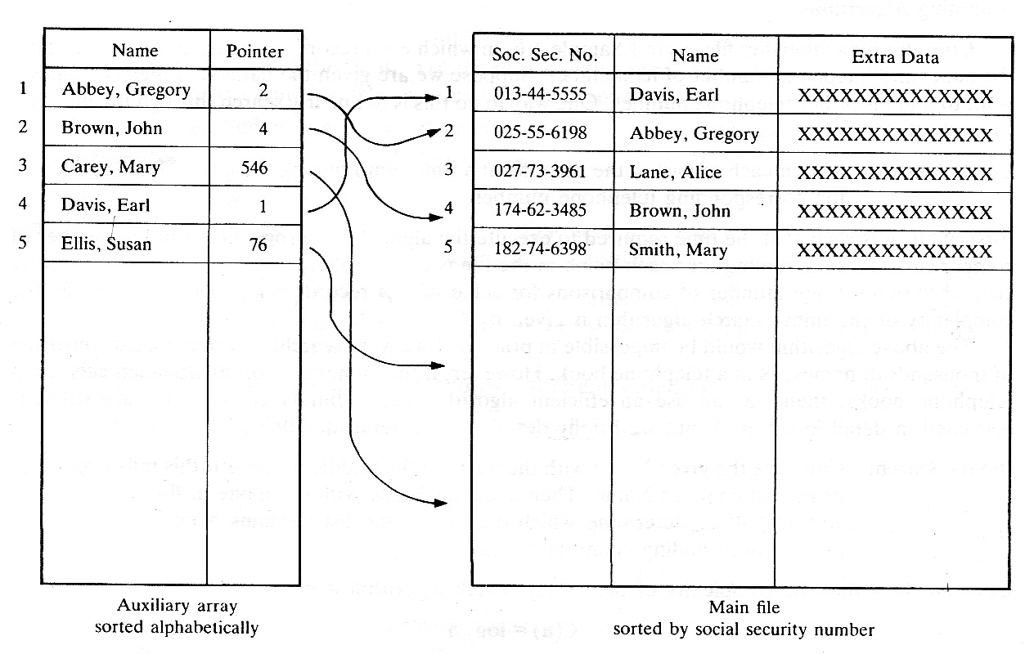
Time-space…

Slide 13
Complexity of Algorithms
The analysis of algorithms is a major task in computer science. In order to compare algorithms, we must have some criteria to measure the efficiency of our algorithms. This section discusses this important topic. The analysis of algorithms is a major task in computer science.
In order to compare algorithms, we must have some criteria to measure the efficiency of our algorithms. This section discusses this important topic.
Suppose M is an algorithm, and suppose n is the size of the input data. The time and space used by the algorithm M are the two main measures for the efficiency of M.

Slide 14
Algorithms
The time is measured by counting the number of key operations-in sorting and searching algorithms, for example, the number of comparisons.
That is because key operations are so defined that the time for the other operations is much less than or at most proportional to the time for the key operations. The space is measured by counting the maximum of memory needed by the algorithm.

Slide 15
Algorithms
The complexity of an algorithm M is the function f(n) which gives the running time and/or storage space requirement of the algorithm in term, of the size n of the input data.
Frequently, the storage space required by an algorithm is simply a multiple of the data size n.
Accordingly, unless otherwise stated or implied, the term “complexity” shall refer to the running time of the algorithm.

Slide 16
Accordingly, unless otherwise stated or implied, the term “complexity” shall refer to the running time of the algorithm.
The following example illustrates that the function f(n), which gives the running time of an algorithm, depends not only on the size n of the input data but also on the particular data.

Slide 17
Example
Suppose we are given an English short story TEXT, and suppose we want to search through TEXT for the first occurrence of a given 3-1etter word W.
If W is the 3-letter word “the,” then it is likely that W occurs near the beginning of TEXT, so f(n) will be small.
On the other hand, if W is the 3-letter word “zoo,” then W may not appear in TEXT at all, so f(n) will be large.

Slide 18
exp
The above discussion leads us to the question of finding the complexity function f(n) for certain cases. The two cases one usually investigates in complexity theory are as follows:
(1)Worst case: the maximum value of f(n) for any possible input
(2)Average case: the expected value of f(n)
Sometimes we also consider the minimum possible value of f(n), called the best case.

Slide 19
exp
The analysis of the average case assumes a certain probabilistic distribution for the input data; one such assumption might be that all possible permutations of an input data set are equally likely.

Slide 20
Example: Linear Search
Suppose a linear array DATA contains n elements, and suppose a specific ITEM of information is given. We want either to find the location LOC of ITEM in the array DATA, or to send some message, such as LOC = 0, to indicate that ITEM does not appear in DATA.
The linear search algorithm solves this problem by comparing ITEM, one by one, with each element in DATA. That is, we compare ITEM with DATA[l], then DATA[2], and so on, until we find LOC such that ITEM = DATA[LOC].
A formal presentation of this algorithm follows.

Slide 21
Algorithm: (Linear Search)
A linear array DATA with N elements and a specific ITEM &f information are given. This algorithm finds the location LOC of ITEM in the array DATA or sets LOC = O.
1. [Initialize] Set K:= land LOC:= O.
2. Repeat Steps 3 and 4 while LOC = 0 and K£ N.
3. If ITEM = DA T A[K], then: Set LOC: = K.
4. Set K: = K + 1. [Increments counter]
[End of Step 2 loop.]

Slide 22
algorithm
5. [Successful?]
If LOC = 0, then:
Write: ITEM is not in the array-DATA.
Else:
Write: LOC is the location of ITEM.
[End of If structure.]
6. Exit.

Slide 23
Complexity
The complexity of the search algorithm is given by the number C of comparisons between ITEM and DATA [K]. We seek C (n) for the worst case and the average case.
Worst Case
Clearly the worst case occurs when ITEM is the last element in the array DATA or is not there at all.
In either situation, we have C (n)=n
Accordingly, C (n) = n is the worst-case complexity of the linear search algorithm.

Slide 24
Average Case
Here we assume that ITEM does appear in DATA, and that it is equally likely to occur at any position in the array.
Accordingly, the number of comparisons can be any of the numbers 1,2,3, . . . , n, and each number occurs with probability p = 1/n.
Then C(n) = 1.
This agrees with our intuitive feeling that the average number of comparisons needed to find the location of ITEM is approximately equal to half the number of elements in the DATA list.

Slide 25

The end

